Slide 1

INFM 600: Information Environments
Week 6: Cleaning Data
Dr. Andrea Wiggins | October 4 & 5, 2016

Slide 2
Today’s Episode
Overview – work plans due today
Ethics
Basics
Vitak et al. key points & discussion
Data cleaning
Van den Broeck et al. key points & discussion
Break
Demo: data cleaning in Excel
Activity: Team project data cleaning
Final notes

Slide 3
Ethics
What is ethics?
“a set of moral principles; the principles of conduct governing an individual or group; a guiding philosophy” (Merriam-Webster)
What is applied ethics?
“what a person is obligated or permitted to do in a specific situation or a particular domain of action” (Internet Encyclopedia of Philosophy)
What is information ethics?
“ethical dilemmas arising from the collection, use, and management of information” (Mason, 1986)
Why do we care?

Slide 4
4 Components of Info Ethics
Privacy: what personal information should individuals be required to disclose and under what conditions
Accuracy: what policies and standards are needed to protect individuals from errors
Property: who owns data and how should ownership be determined
Access: who can have access to what information
Source: Culnan & Williams (2009)
Notes:
Facebook:
Privacy: You are technically required to provide your real name
Accuracy: You can report photos that are erroneously tagged of you
Property: You own your data, FB can use it
Access: You can access your information at any time. You can dl your data.

Slide 5
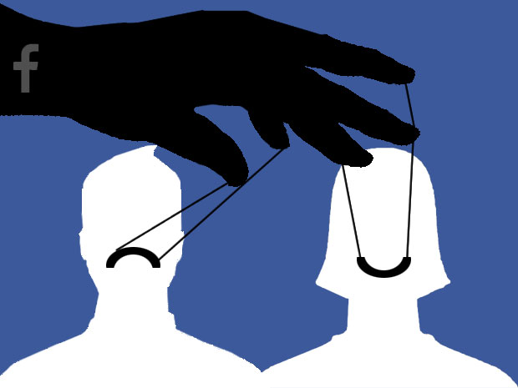
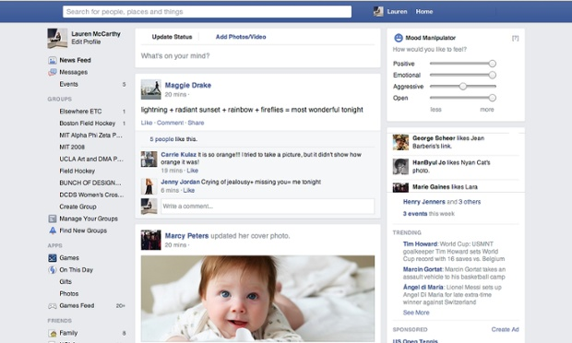
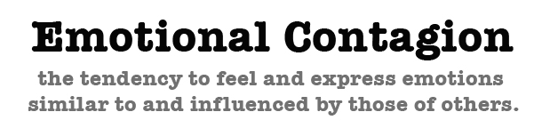
Facebook Study
Kramer, A., Guillory, J. and Hancock, J. Experimental evidence of massive-scale emotional contagion through social networks. PNAS, 111, 24 (2014), 8788-
8790.

Slide 6
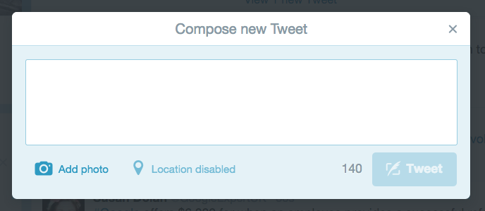
Facebook Study
Were Facebook users harmed?
I wonder if Facebook KILLED anyone with their emotional manipulation stunt. At their scale and with depressed people out there, it’s possible.

Slide 7
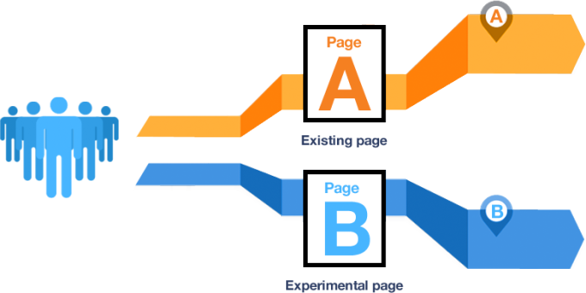
Facebook Study
Did participants give consent?

Slide 8
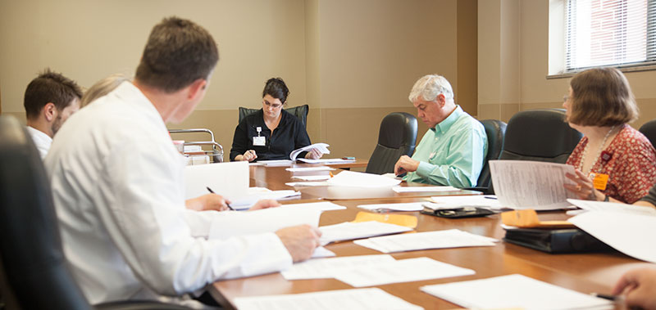

Facebook Study
Was the research ever reviewed?

Slide 9
Facebook Study
Does the study involve issues around…
Privacy? (what personal information should individuals be required to disclose and under what conditions)
Accuracy? (what policies and standards are needed to protect individuals from errors)
Property? (who owns data and how should ownership be determined)
Access? (who can have access to what information)

Slide 10
“Research at Facebook”
As of October 2, 2014
New guidelines
New review
New training
Research website
Notes:
Guidelines: if work is focused on studying particular groups or relates to content that may be considered deeply personal, it will go through an enhanced review process. There will also be more review for collaborative work.
Review: Internal review panel.
Training: New ethics training is incorporated into Facebook’s six week “bootcamp” for new hires
Research website: our published academic website is now available at a single location and will be updated regularly.

Slide 11
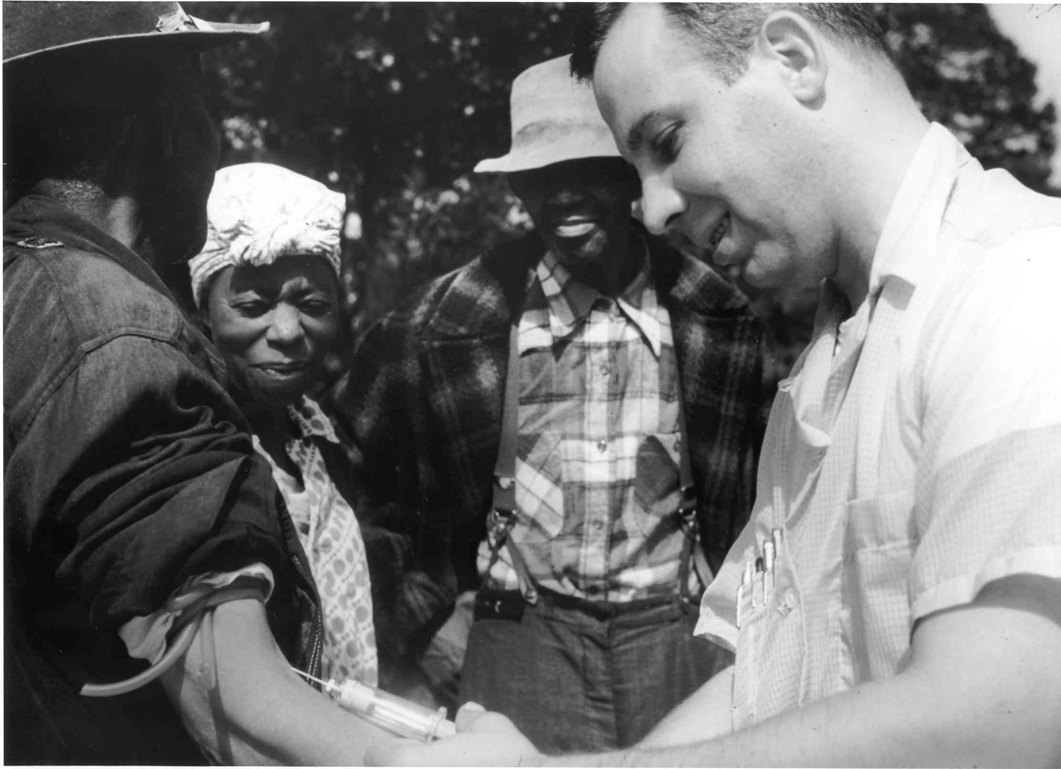
Belmont Report Basics
UMD (& companies like MSR) uses the Belmont Report as a foundation for human research ethics
Notes:
The tuskegee syphilis experiment was research study conducted between 1932 and 1972 by the united states U.S> Public Health Service.
During this time, the US health service worked with 600 impoverished sharecroppers in Alabama, infecting 200 with syphilis and not treating the entire group, although they did provide free healthcare for all other ailments.
Participants were not told they had syphilis or that they were part of a research study. Because syphilis is a terminal disease, all eventually died.

Slide 12
Belmont Report Principles
Respect for persons: All individuals should be treated as autonomous agents
→ Informed consent
Beneficence: Researchers should respect their participants & protect them from harm.
→ Assessment of risks & benefits
Justice: Risks & benefits of research should be distributed equally between individuals & groups.
→ Selection of subjects
Notes:
…and persons with diminished autonomy deserve enhanced protections. Protocols should be designed to minimize risks to research participants while maximizing benefits to participants and to society. If one group bears a disproportionate amount of risk, that same group should receive a disproportionate benefit.
Informed consent: Research subjects, “to the degree that they are capable,” should be able to choose what happens to them through informed consent.
Assessment of risks and benefits: The risks and benefits of research should be assessed by an investigator, a review committee, and prospective subjects.
Selection of subjects: Both individuals and groups should be selected to balance the risks and benefits of research.

Slide 13
Key Conflict Zones
In conflict zones, established ethical norms for human subjects research conflict with practices that new technologies support.
It may be unclear…
What is considered research.
What is considered human subjects research.
What research should be exempt from review.
What is a reasonable expectation of privacy and security.
Notes:
What if a study primarily designed to improve a product uncovers knowledge that merits publication? Is research with avatars human subjects research? Should research on existing data sets be exempt from ethical review? What if these data contain sensitive personal information? What if these data are combined with other data? Are social media posts public, or private? What steps should researchers take to ensure that participant identities cannot be reconstructed?

Slide 14
Key Conflict Zones
It may also be unclear…
What is a reasonable expectation of consent.
How beneficence and justice should be evaluated.
How risks and benefits should be evaluated.
Who participants are.
Notes:
Is research that collects consent through the use of a site with set terms and conditions acting ethically?
Is it ethical to use Mechanical Turk workers as participants? Under what circumstances? If a researcher observes dangerous online behavior, is she obligated to intervene?
If participants unknowingly engage in risky online behavior, is it ethical for knowledgeable researchers to study that behavior without intervening?
Data about humans may be embedded in other data (e.g., geotagged images). Data about secondary participants (e.g., digital photographs of Facebook friends) may be embedded in primary data.

Slide 15
Vitak et al. (2016)
Were ethics beliefs and attitudes substantially different according to research discipline?
Were ethics beliefs and attitudes substantially different for industry researchers and academic researchers?
What are some examples of ethics practices in this paper that relate to data cleaning?
What did you find surprising, worrisome, or reassuring about these research results?

Slide 16
Discuss: Ethics & Data Cleaning
What were the top reasons (from the online discussion) to pair these topics?
What other course topics could have important ties to ethics?

Slide 17
Van den Broeck et al. (2005)
Definition of data cleaning?
“process of detecting, diagnosing, and editing faulty data”
What is the purpose of data cleaning?
Identify & correct errors to minimize impact on results
What do the authors identify as problematic about “data cleaning” as a practice?
Viewed as manipulation → dishonest!
What are the key steps in the data cleaning process?
Screening, diagnosing, editing
Rinse & repeat

Slide 18
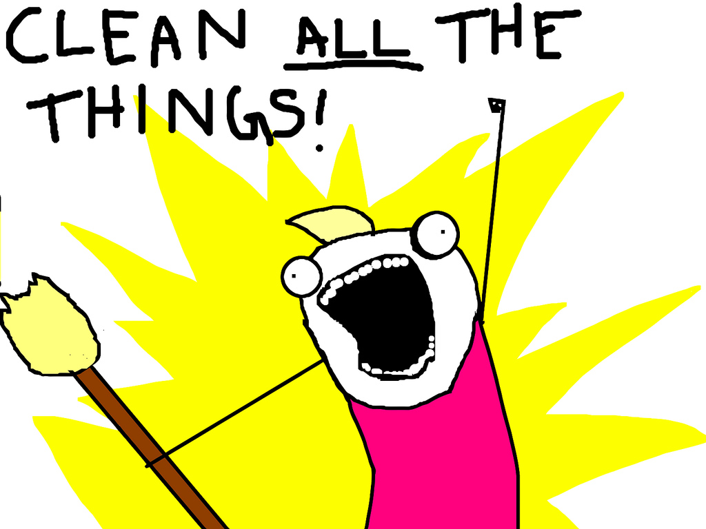
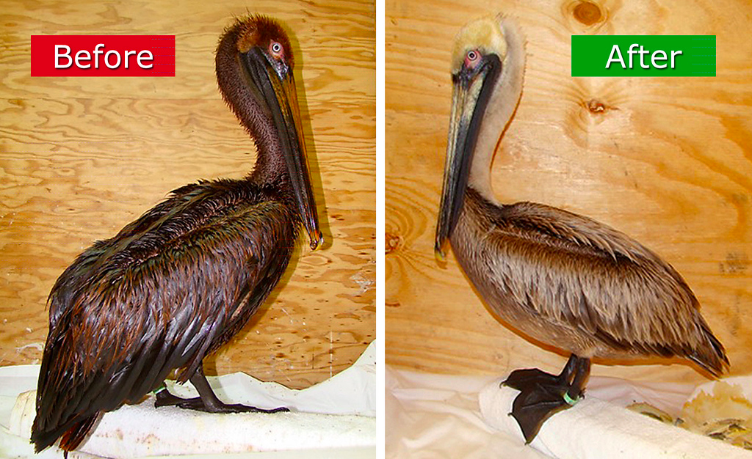
Van den Broeck et al. (2005)
What should analysts pay attention to for screening?
Lack/excess of data
Outliers & inconsistencies
Strange patterns
Suspicious analysis results
What should analysts consider for diagnosis?
Errors, missing data
True extreme, true normal
No diagnosis but still suspicious…
What kind of editing is recommended?
Correction
Deletion
Unchanged (but possibly flagged)

Slide 19
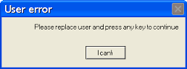
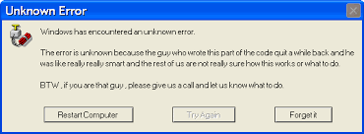
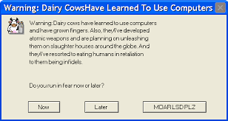
Sources of error
What are causes problems for data at each stage?
Questionnaire
Form-based problems
Respondent-based problems
Database
Data entry problems
Data management issues
Analysis dataset
Un-synced editing
Analyst errors
Extraction/sorting/calculation

Slide 20
Data screening methods
Form-checking
Validated &/or double data entry
Sort & browse tables
Print variables that don’t pass range checks
Print records that don’t pass consistency checks
Use box plots, histograms & scatter plots to view distributions
Plot repeated measurements of the same individual
Frequency distributions & cross-tabulations
Summary statistics
Statistical outlier detection

Slide 21
Practical strategies
See Week 6 module for supplemental material containing…

Slide 22
Break
10 minutes!

Slide 23
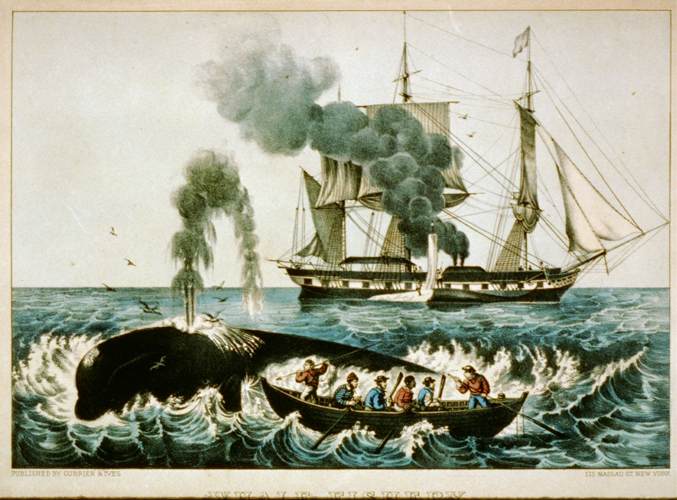
Demo
Data set headers:
LastName, FirstName, Vessel, Rig, ApproximateDeparture, FullName, Age, Height, Skin, Hair, Eye, Residence, Rank, Lay, Remarks, VoyageNumber, VesselNumber
Description:
Personnel details of crew lists for whaling ships leaving the port of New Bedford, MA, 1809—1927
Provenance & known issues:
Public library project digitized records for 1809-1839
31 museum volunteers digitized records for 1840-1927
Crew list records were manually transcribed by chaplains from original handwritten Customs documents
Customs officers were unfamiliar with spelling of names
Many seamen in 1800’s also didn’t know how to spell their names!
https://en.wikipedia.org/wiki/Whaling_in_the_United_States
Notes:
Ask: who would be interested in these data?

Slide 24
Demo
Data set headers:
LastName, FirstName, Vessel, Rig, ApproximateDeparture, FullName, Age, Height, Skin, Hair, Eye, Residence, Rank, Lay, Remarks, VoyageNumber, VesselNumber
What are our assumptions? What are our expectations?
What cleaning steps should we take for the full data set?
What cleaning steps should we take for specific attributes?
What should we keep track of as we go?

Slide 25
Activity
Work with your project team
Select 1-2 columns of data from your project data set
Test some of the applicable data cleaning procedures we’ve discussed
Keep track of the steps you took & decisions you made
If you finish cleaning one column, try another!
Another approach: each team member can take a column and work with it in parallel

Slide 26
Suggested Data Cleaning Tasks
Fill in null fields: based on what rationale?
Identify records to remove and why
Check for character set problems
Check temporal ordering for “impossible” sequences
Verify there are no “illegal” values
Check distributions of values, identify outliers, & examine details
Transform nominal variables to ordinal values
Min, max, mean
Standard deviation

Slide 27
Final notes
Make sure you have a Wikimedia or Wikipedia account set up for class next week
5 online discussions planned for rest of semester: allocate your effort wisely!
Week 8: documenting data processing
Week 11: data visualization
Week 12: workflows
Week 13: audiences
Week 14: People’s Choice (topic TBD after next week’s feedback)

